Slide 1



Group 5 – C0910GS4 – Fat 2

Slide 2
Introduction
Auto Ancillaries Limited (AAL) is in the business of manufacturing important ancillaries for the two-wheeler and four-wheeler automobile industry. We has an annual turnover of 15 million dollars. The company has 4 factories and 4 warehouses. AAL customers are Original Equipment Manufacture (OEM).

Slide 3
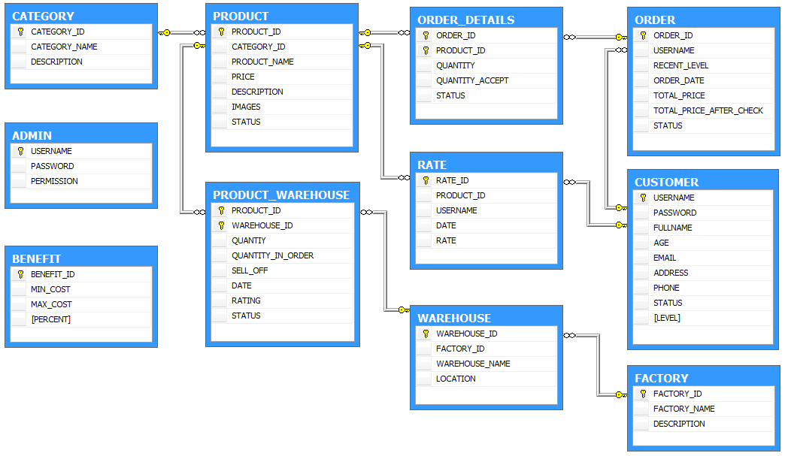
Database Design

Slide 4
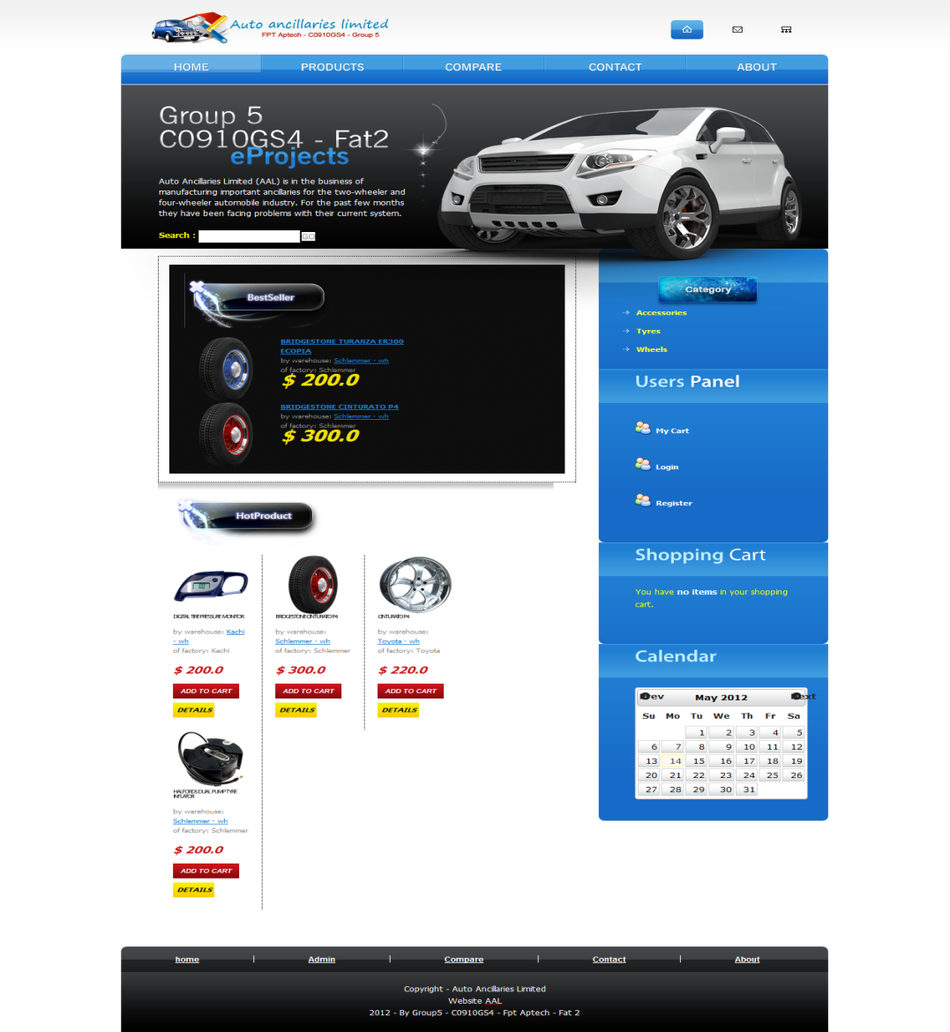
Service
We offer accessories for the two-wheeler and four-wheeler automobile industry.With best quality and low price.

Slide 5
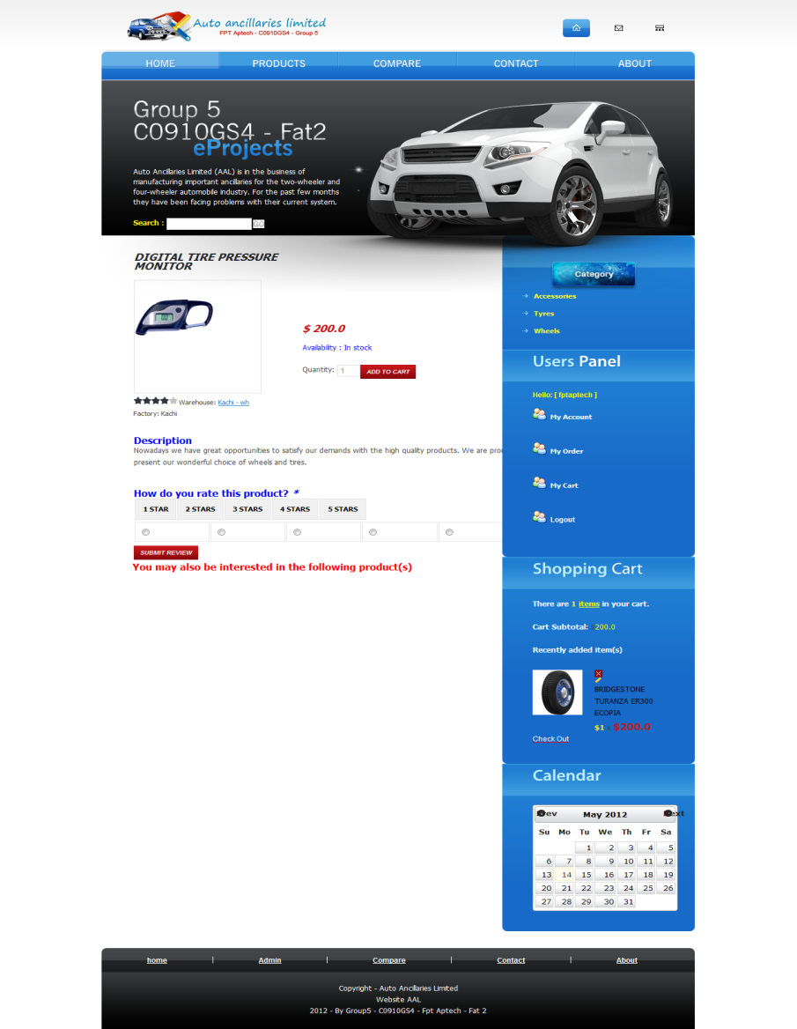
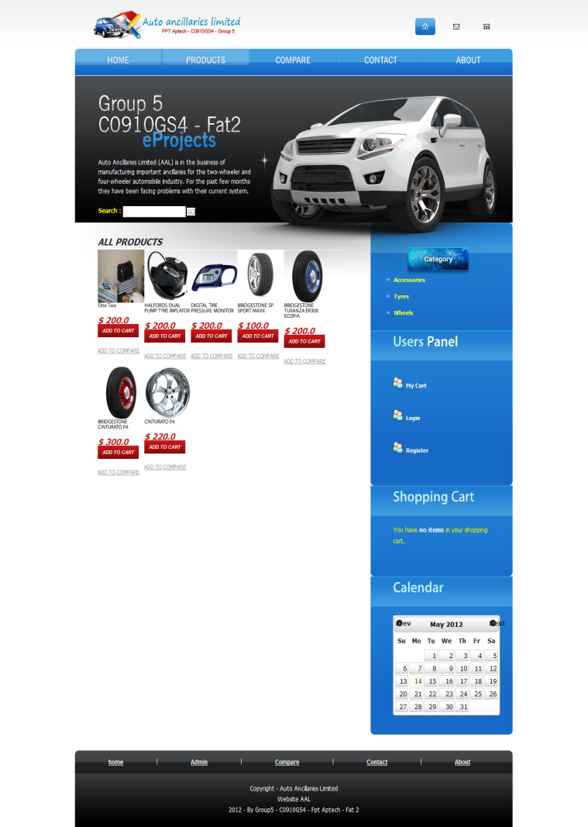
View
Description of the contents
View All Product in Stores
View Detail Product
View Product by Category

Slide 6
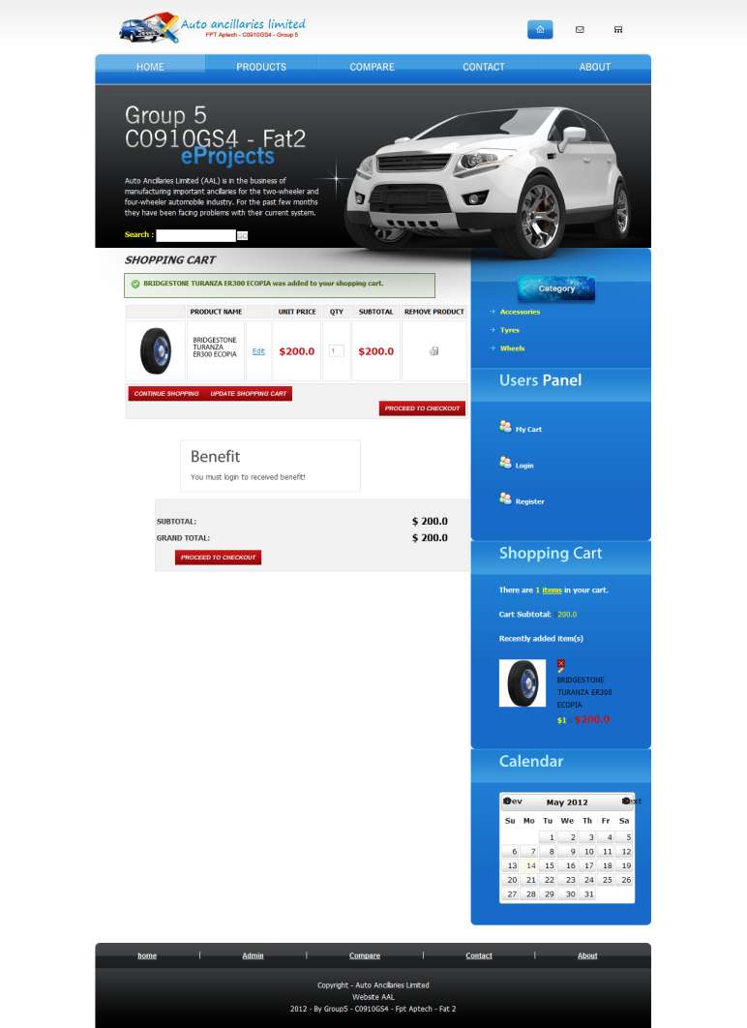

Shopping Cart
View Price with quantity of products
Remove choose products
Account Benefit viewer

Slide 7
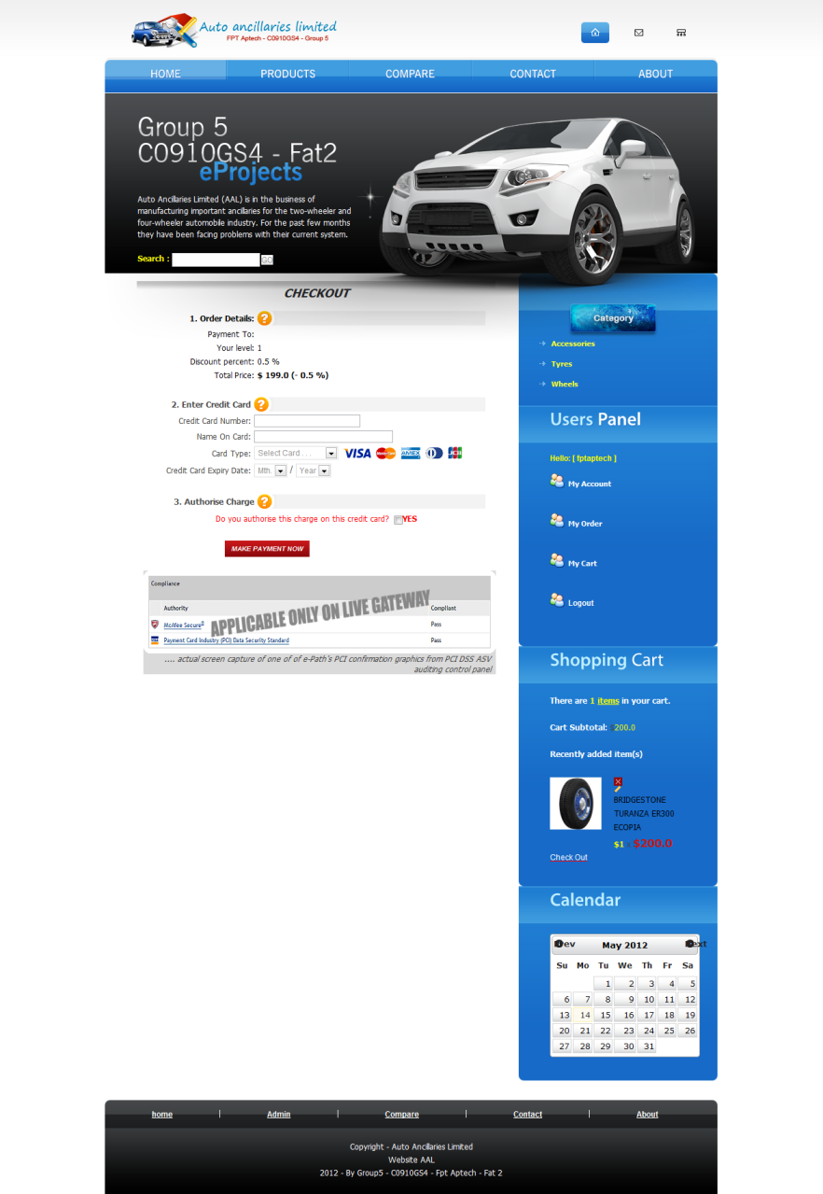
Payment
1.
Pay with Credit Card
2.
Verify with Admin and Ware House Manager
Protected

Slide 8



About
Dam Quang Hieu (Leader)
Nguyen Quy Trong
Nguyen Quy Bao
Group 5 – C0910GS4

Slide 9


Thank You!
We are many thank the homeroom teacher Mr. Nguyen Ngoc Tu and teacher guides Mr. Pham Huu Tung for helping us complete eProject.

